Slide 1
The webinar will begin in a few moments…

Slide 3
Wound Care is An Essential Service During COVID-19 Pandemic
Statement from the Wound Healing Society
Lisa J. Gould, MD, PhD, FACS
Member BOD, WHS

Slide 4
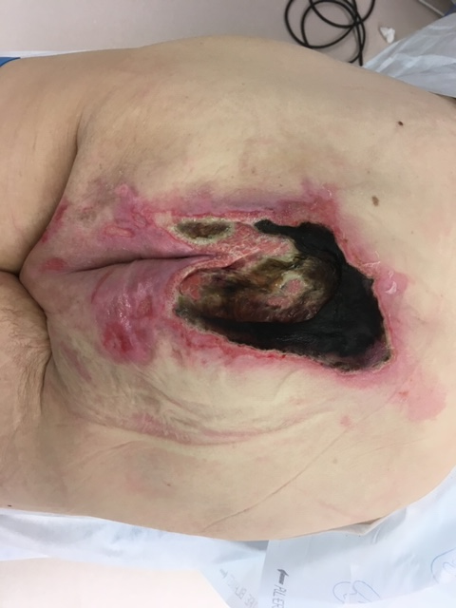
One Month Ago:
Statement from the Alliance of Wound Care Stakeholders (March 20, 2020)
Wound Care is an Essential – Not Elective – Service that Prevents Hospital Admissions and ED Visits
Among a Fragile Cohort of Patients at High-Risk of COVID-19
Today:
Many Wound Centers are Closed
Clinical Trials on Hold
Patients in SNFs are in ‘lock down’

Slide 5
Goals
At the conclusion of this presentation you should be able to discuss:
How wound care clinicians provide a critical service to keep patients out of the hospital
How to keep your staff and your patients safe
How to prepare for the post-surge reality

Slide 6
Why Are Wound Patients Special?
High number of comorbidities
  Obesity
  Diabetes
  Hypertension
  COPD
  Age >60
  Immunosuppression
Medically Complex
  Recurrent Admissions
  Infection
  Amputation
  High morbidity and mortality

Slide 7
Role of the Wound Center
Prevent Hospital Admissions
Reduce use of the emergency rooms
Reduce emergent operations
  Prevent infections
    Outpatient debridement
    Topical wound care
  Early diagnosis of infection with close follow-up
  Pain reduction
Coordinate Complex Care

Slide 8
A moderated approach
Review and prioritize
  Cancel all non-essential appointments
  Categorize
    Patients who must be seen
      High risk for infection
      Necrotic tissue undergoing serial debridement
      No reliable wound care at home
      Treatment with CTP (critically evaluate the response)
      In compression with high drainage
    Patients who can be seen less frequently
      2-3 weeks
        Wound care provided by VNA
        Change in wound necessitating change in wound care strategy
        Patient and/or family is reliable
      4-6 weeks
        Stable wound with stable wound care
    Patients who do not need to be seen (or cannot be seen)
      Residents of skilled nursing facilities
      No open wounds
      Extended follow up in very stable patients

Slide 9
Telehealth
Reimbursement is same as in person E&M
Real-time communication
  Telephone with photos
  Audio/video telecommunication
    Facetime
    Zoom
    Doxy.me
    Skype
Clinic nurses call patient and determine capability
Schedule time with a 1 hour window
  Shows on schedule as telehealth visit with desired modality
  If possible schedule with VNA or SNF nursing staff

Slide 10
Tips for Wound Telehealth
Best to have VNA nurse or other provider
Supplemental lighting for deep wounds
Video is better than still photos
Organize the visit, keep track of time
  COVID questions
  ROS
    Does the patient have fevers, chills, new pain or increased pain or change in blood sugars?
  Wound evaluation
      Is there undermining or tunneling?
      What does the drainage look like?
      Has drainage increased?
      Is drainage blue-green with musty or fruity smell?
      Malodor after the dressing was removed?
      Is it firm around the wound?
      Measurements if possible
Use a template

Slide 11
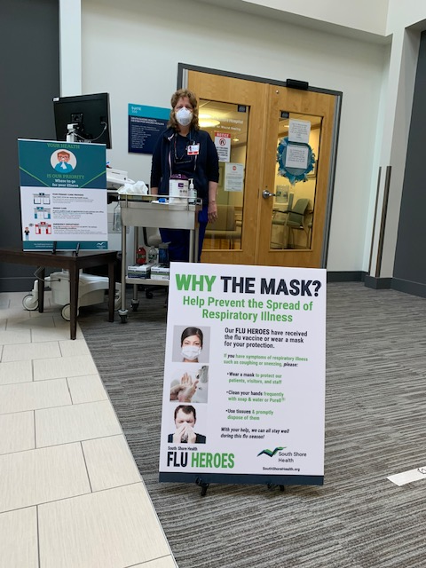
Wound Clinic Daily Operations
Limit points of entry
Install physical barriers (glass or plastic) at reception area
Screening station
  COVID questions
  Temperature
    Defer clinic visit if appropriate
  Provide facemask if patient doesn’t have one
  Visual alerts
  Reduce crowding
    No visitors unless essential for patient’s emotional well-being and care
EMS must call ahead

Slide 12
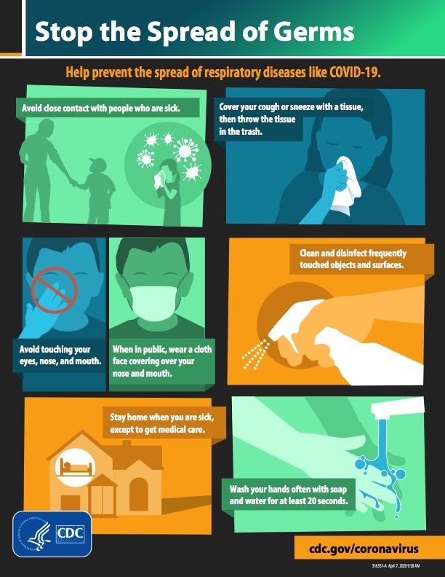
Wound Clinic Daily Operations
Educate patients
  COVID symptoms
  Hand hygiene
  Respiratory hygiene
  Cough etiquette
  Physical distancing
Physically separate patients with symptoms, suspected or confirmed COVID-19

Slide 13
Use Time and Clinic Personnel Wisely
Teach patient or family members to do wound care
  American College of Surgeons Wound Management Home Skills program, https://www.facs.org/education/patient-education/skills-programs/wound-care
Emphasize preventive measures
    Edema control
    Nutrition
    Stress relief/sleep hygiene
    Hydration
    Pressure relief
    Hand Hygiene
Care coordination
  Secure e-mail with outside providers
  Invite your referring physician for a combined visit
  Connect with VNA
    Limit use of daily dressings
    Try twice weekly or weekly if possible
      Patient, family or other caregivers can do interim with VNA guidance

Slide 14

Use Additional Time/Personnel Wisely
  Utilize clinic nurses for phone contact with patients
    Even wellness checks will let patients know you are still there for them

Slide 15
Keep Wound Care Essential
  Cancel all elective procedures in patients with a vital or functional prognosis that will not be significantly worse after a two-month delay in treatment.
    Patients with chronic wounds considering flap reconstruction
    Ulcerated but stable, ie, slow growing skin cancers
  Perform day surgeries at an ambulatory facility and limit the number of people scrubbed to the absolute minimum
  Keep a log of patients who do require surgery
Inpatient Wound Care
  Review the consult list as a team, utilize photos as a form of telehealth
  Identify patients for whom debridement will facilitate earlier discharge
  Communicate with the primary team regarding follow up as outlined above

Slide 16
At Some Point They Will Need to be Seen…
CDC COVID-19 guidance for ambulatory facilities
Goals:
1) minimize disease transmission to patients, healthcare personnel (HCP) and others
2) identify persons with presumptive COVID-19 disease and implement a triage procedure to assign appropriate levels of care
3) reduce negative impacts on emergency department and hospital bed capacity
4) maximize the efficiency of personal protective equipment (PPE) utilization across the community health system while protecting healthcare personnel.

Slide 17
How to manage patients with respiratory illness, including COVID19
Triage
Isolate symptomatic patients, suspected or confirmed COVID-19
  If patient is arriving via transport, EMS personnel should contact the receiving department
  Set up separate, well-ventilated triage areas
  Place patients in private rooms with door closed
  Don appropriate PPE – note that wound care is considered a high-contact patient care activity and therefore gowns should be utilized
Transporting from entry to exam room and back.
    Patients should wear a facemask to contain secretions during transport. If patients cannot tolerate a facemask or one is not available, they should use tissues to cover their mouth and nose.
    Use of a facemask by the transporter is recommended for anything more than brief encounters with COVID-19 patients.
    Additional PPE should not be required unless there is an anticipated need to provide medical assistance during transport (e.g., helping the patient replace a dislodged facemask)

Slide 18
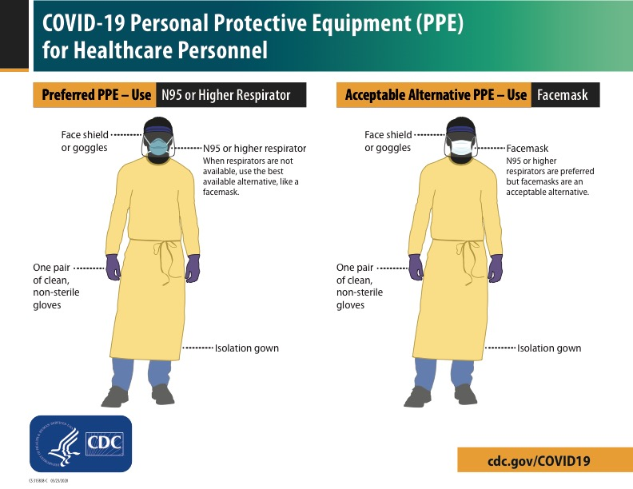
Learn to Don/Doff

Slide 19
Be Safe and Make This an Opportunity
‘Temporary’ changes may become the norm
  Telehealth with appropriate reimbursement
  Streamlining documentation
  Use of ‘Wound Apps’
  Empowered advanced practice nurses
Patient and Caregiver Education leads to better outcomes
Keeping patients in their homes
Improved coordination of care
Bring the Wound Care Community together
  Societies to present a united stance demonstrating that Wound Care is an Essential Service

Slide 20
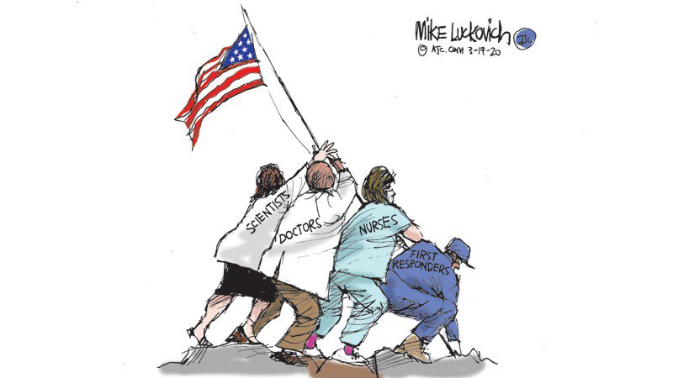

Thank you!
Please use the Q&A box to ask questions

